Slide 1
Stereo Geometry

Slide 2
Stereo Set-up
X
Epipolar plane
l,l’: Epipolar lines
x
x’
l
l’
e
e’
C’
C
e, e’: epipoles
Camera centers

Slide 3
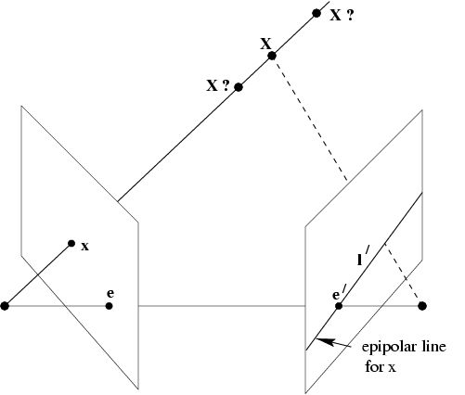
Epipolar geometry
Corresponding point of x in the right image lies on l’.
From Hartley and Zisserman, “Multiple view geometry in computer vision”, Cambridge Univ. Press (2000)

Slide 4
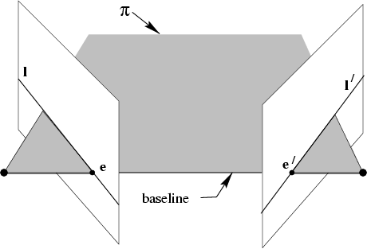
Epipolar geometry
All points on π project on l and l’
From Hartley and Zisserman, “Multiple view geometry in computer vision”, Cambridge Univ. Press (2000)

Slide 5
Epipolar geometry
Epipoles e,e’
= intersection of baseline with image plane
= projection of projection center in other image
= vanishing point of camera motion direction
An epipolar plane: plane containing baseline (1-D family)
An epipolar line: intersection of epipolar plane with image (always come in corresponding pairs)

Slide 6
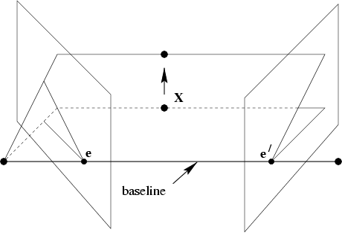
Epipolar geometry
Family of planes π and lines l and l’
Intersection in e and e’
From Hartley and Zisserman, “Multiple view geometry in computer vision”, Cambridge Univ. Press (2000)

Slide 7
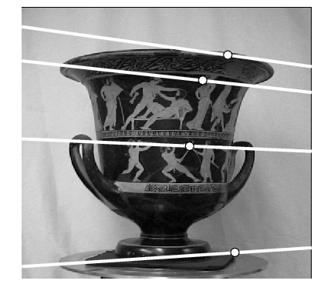
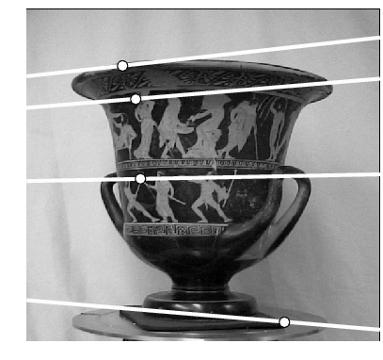
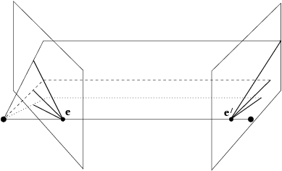
Example: converging cameras
From Hartley and Zisserman, “Multiple view geometry in computer vision”, Cambridge Univ. Press (2000)

Slide 8
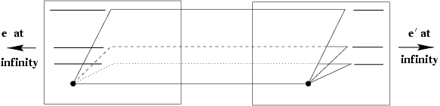
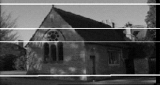
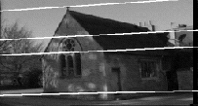
Example: motion parallel with image plane
From Hartley and Zisserman, “Multiple view geometry in computer vision”, Cambridge Univ. Press (2000)

Slide 9
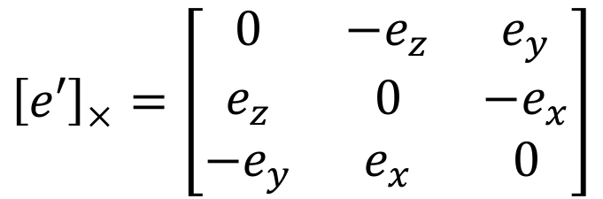
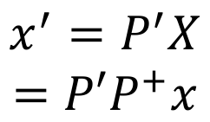
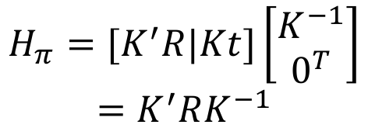
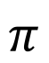
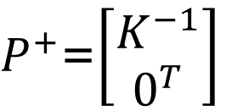
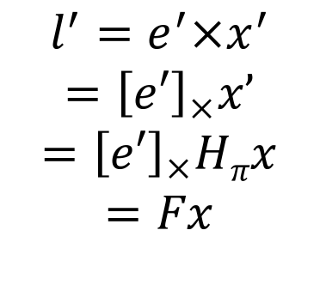
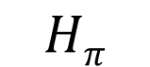
Epipolar Geometry
X
Epipolar plane
For scene points lying on plane at infinity.
x
x’
l
l’
e
e’
C
C’
P=K[I | 0]
P’=K’[R | t]
F=[e’]_{x}K’RK⁻¹
Coplanar: X, x, x’, C, C’, e, e’, l, l’

Slide 10
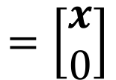
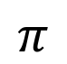
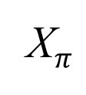

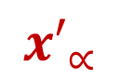
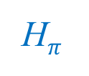
Epipolar line: Finite segment!
X
Y
x
y
l
e’
C’
C

Slide 11
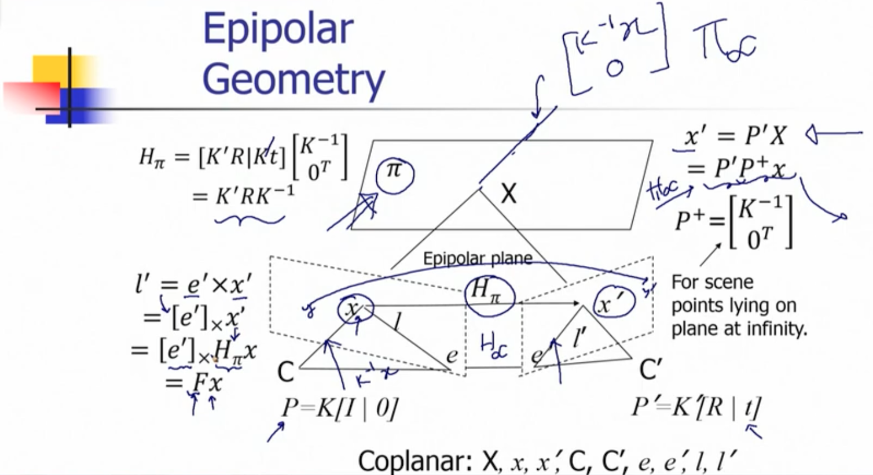

Slide 12
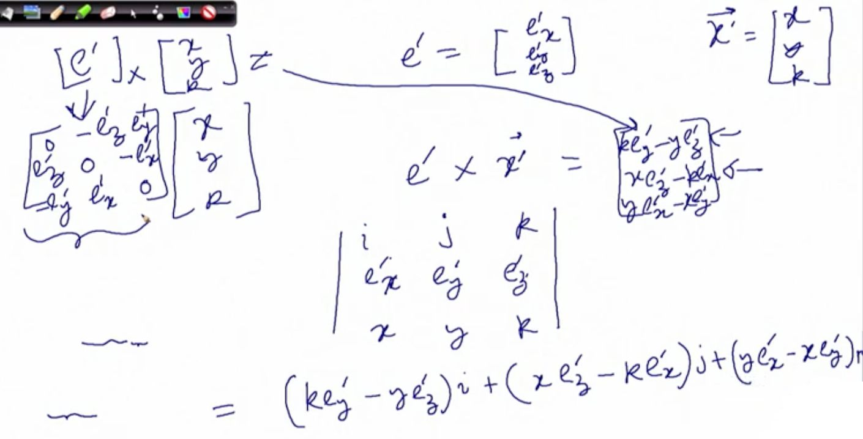

Slide 13
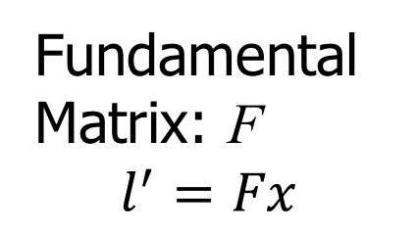
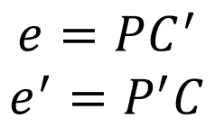
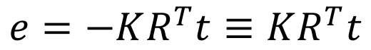
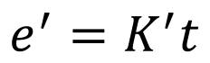
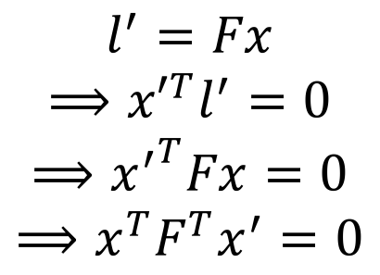
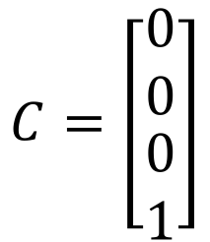
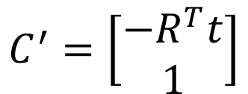
Epipolar Geometry
X
x
x’
l
l’
C
C’
e
e’
P=K[ I | 0]
P’=K’[ R | t]

Slide 14
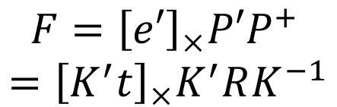
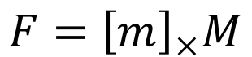
Fundamental and Essential Matrices
P= K[I | 0]
P’= K’ [R | t]
Say, P=[I | 0], i.e. K=I
P’=K’ [R | t]=[K’ R | K’ t]=[M | m]
Essential Matrix (E)

Slide 15
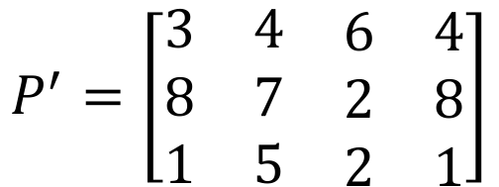
Ex. 1
Consider the following stereo imaging matrices given by P =[I|0] (ref. camera) and P’ as follows.
Compute the fundamental matrix of the system.

Slide 16
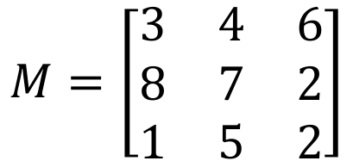
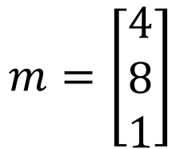
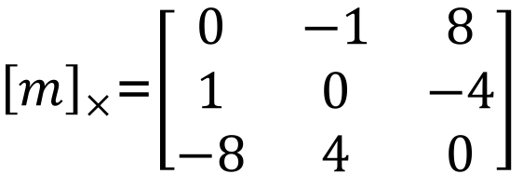
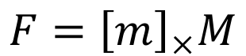
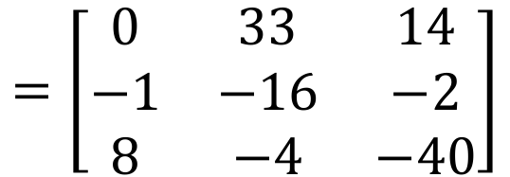
Ans. 1

Slide 17
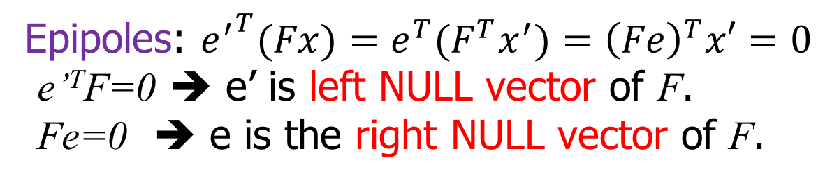
Fundamental Matrix: Properties
P
P’
Transpose:
If F is fundamental matrix of (P,P’), F^{T} for (P’,P).
Epipolar lines: For x, epipolar line l’=Fx.
For x’, epipolar line l=F^{T}x’.
F is a correlation.
Rank deficient.
Inverse does not exit.
Rank deficient:
det(F)=0 and F is a projective element → 7 d.o.f.

Slide 18
Estimation of Fundamental Matrix
~10000
~10000
~100
~10000
~10000
~100
~100
~100
1
Orders of magnitude difference
Between column of data matrix
→ least-squares yield poor results
!

Slide 19
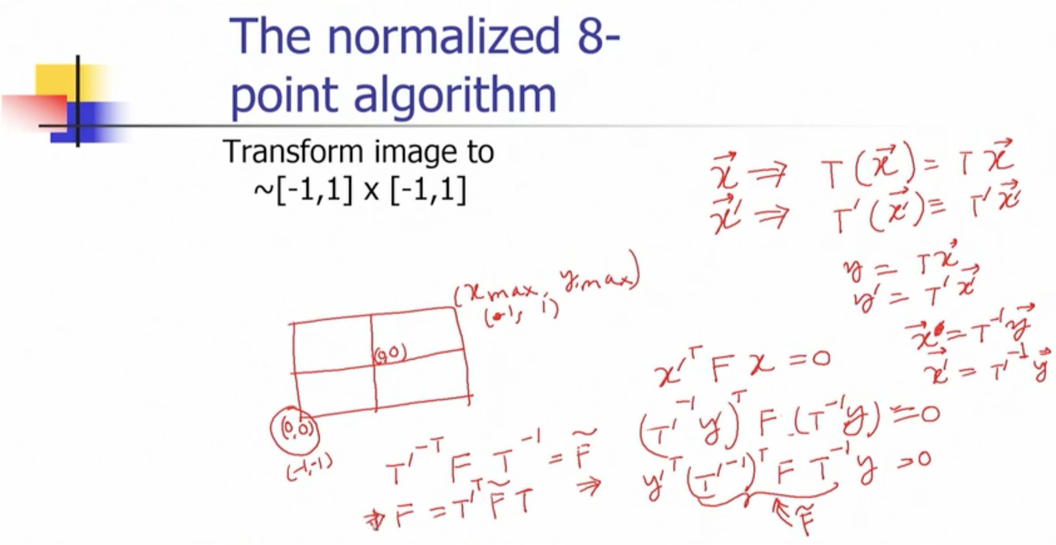

Slide 20
The normalized 8- point algorithm
Transform image to
~[-1,1] x [-1,1]
⎡ 2
0 − 1
2
⎤
⎢700
⎥
(-1,1) (1,1)
(700,500)
⎢
⎢
⎢
⎢
⎢⎣
⎥
− 1⎥
⎥
1 ⎥
⎥⎦
(0,500)
(0,0)
500
(-1,-1) (1,-1)
(0,0)
(700,0)
Least squares yields good results
(Hartley, PAMI´97)

Slide 21

The singularity constraint
detF = 0 rank F = 2
SVD from linearly computed F matrix (rank 3)
⎡σ₁
⎤
⎥
F = U⎢ σ
T T
V = U σ V + U σ V^{T} + U σ V^{T}
⎢
2
_{σ} ⎥
1 1 1 2 2 2 3 3 3
⎣
min F- F'
3 ⎦
F
Compute closest rank-2 approximation
⎡σ₁
⎤
⎥
F'= U⎢ σ
T T
V = U σ V + U σ V^{T}
⎢
2
₀⎥
1 1 1 2 2 2
⎣
⎦

Slide 22
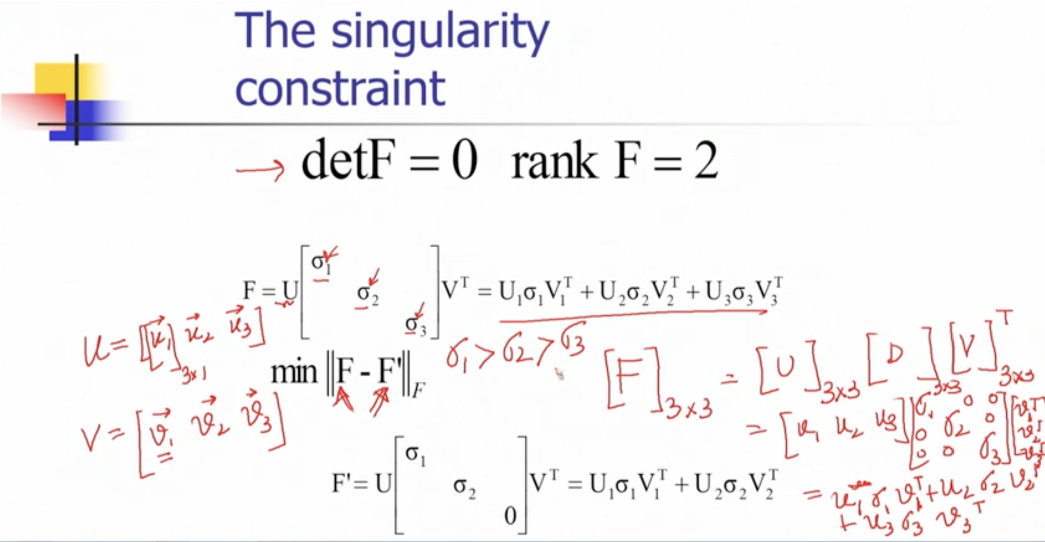

Slide 23
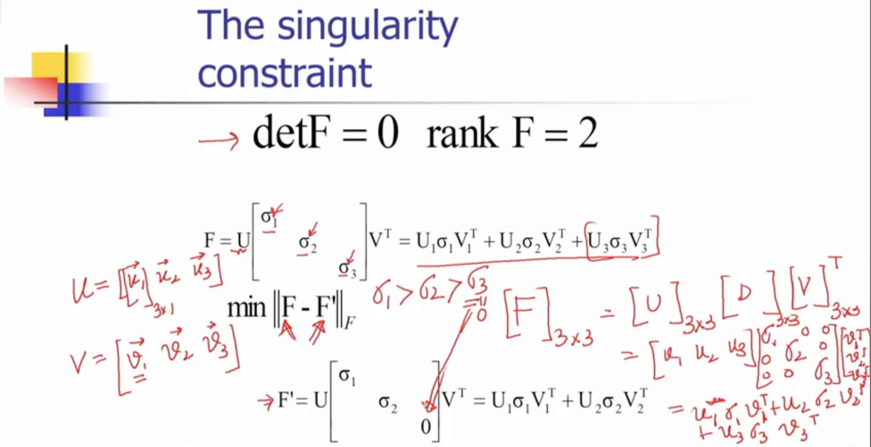

Slide 24
Algebraic Minimization Algorithm
The algebraic minimization algorithm is a method for estimating the fundamental matrix from point correspondences.
The algorithm works as follows:
First, the normalized 8-point algorithm is used to estimate an initial fundamental matrix F.
The singular value decomposition (SVD) of F is then computed.
The singular matrix F* that minimizes the difference between F and F* is found.
The algebraic minimization algorithm is more accurate than the normalized 8-point algorithm because it takes into account the fact that the fundamental matrix is a singular matrix.

Slide 25
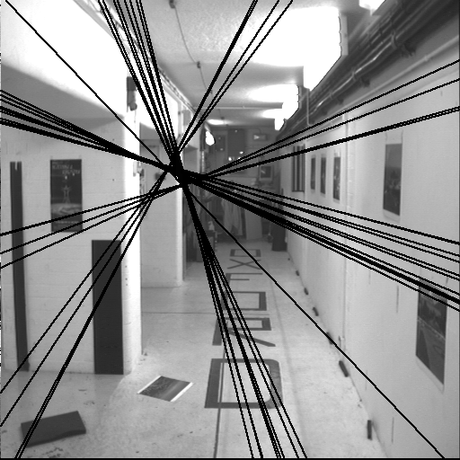
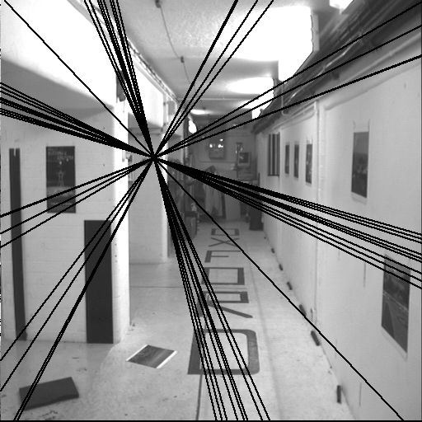
The singularity constraint
Singular F
Nonsingular F
Non-singular F causes epipolar lines not converging.
From Hartley and Zisserman, “Multiple view geometry in computer vision”, Cambridge Univ. Press (2000)

Slide 26

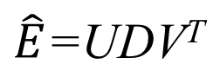
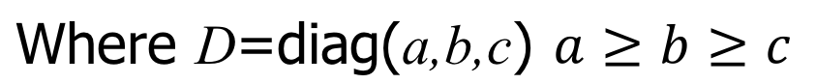
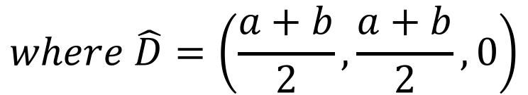
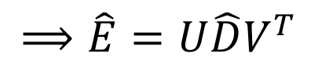
The singularity constraint for Essential Matrix
det(E)=0
For essential matrix, two singular values are the same.

Slide 27
Geometric distance
This section describe ways minimize a geometric image distance.
Parametrization of rank-2 matrices:
The non-linear minimization of the geometric distance cost functions requires a parametrization of the fundamental matrix which enforces the rank 2 property of the matrix.

Slide 28
There are a number of ways to parametrize the fundamental matrix.
One way is to over-parameterize it, which means that we use more parameters than are strictly necessary. This is often done by writing the fundamental matrix as the product of a non-singular matrix and a skew-symmetric matrix.
Another way to parametrize the fundamental matrix is to use the epipolar parametrization. This parametrization specifies the first two columns of the fundamental matrix, along with two multipliers α and β such that the third column can be written as a linear combination of the first two columns.

Slide 29
Finally, the both epipoles as parameters parametrization specifies both epipoles as parameters. This parametrization is more general than the epipolar parametrization, but it is also more complex.

Slide 30
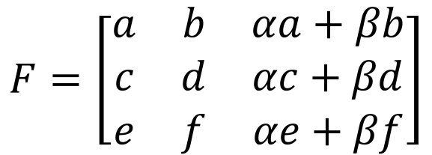
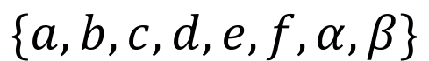





Parametric representation of F
X
x
l’
x’
l
C e’
P
C’
P’
e
Over parameterization: F=[t]_{x}M ➔ {t,M} → 12 params. Epipolar parameterization:
Left epipole
Both epipoles as parameters
Epipoles

Slide 31
Experimental evaluation of the algorithms
Algorithms Being Compared:
Algorithm 1: The normalized 8-point algorithm
Algorithm 2: Minimization of algebraic error with the singularity constraint.
Algorithm 3: Geometric distance algorithm

Slide 32
Experimental Setup:
For each pair of images, you randomly select a number of matched points. Let's call this number "n.”
Fundamental Matrix Estimation:
Using the selected "n" matched points, you estimate the fundamental matrix for each algorithm.
Residual Error Calculation:
After estimating the fundamental matrix, you calculate a residual error. This error likely represents how well the estimated fundamental matrix aligns with the actual point correspondences in the image pair.

Slide 33
Repetition:
This entire process is repeated 100 times for each value of "n" and for each pair of images. So, you're conducting 100 trials for different combinations of "n" and image pairs.
Data Collection:
For each combination of "n" and image pair, you collect the average residual error. This will give you a dataset of average residual errors for each algorithm at various values of "n.”
Plotting:
Finally, you plot the average residual error against the number of matched points "n." This helps you visualize how the different algorithms perform as the number of points increases. It can show which algorithm is more robust or accurate as the data becomes more abundant.

Slide 34
Range of Points "n":
The number of points "n" used ranges from 8 (the minimum) up to three-quarters of the total number of matched points. This means you're evaluating the algorithms at different levels of data complexity, from a small subset of points to a substantial portion of the available points.
Overall, this experimental procedure allows you to compare the performance of the three algorithms under different conditions, providing insights into how they behave as the quantity of input data (number of matched points) varies.
This type of analysis is valuable for selecting the most suitable algorithm for a particular computer vision task based on the available data and the desired level of accuracy.

Slide 35
Computing scene points (structure)
X
x
l’
x’
l
C
P
e
e’
C’
P’
Given x_{i} ←→x_{i}’, compute X.
1. Compute F.
Perp. segm.
x_{i}
x_{i}’
2. Compute P and P’.
C
C’
For each (x_{i},x_{i}’) compute X by triangulation.
Compute intersection of Cx_{i} and C’x_{i}’.
Compute segment perpendicular to both.
Get the mid-point.
Not projective invariant, i.e. (PH,P’H) does not give H⁻¹X.

Slide 36

Minimizing Reprojection Error
X
x
l’
x’
l
C
P
e
e’
C’
P’
Given x_{i} ←→x_{i}’, compute X.
Projective invariant.

Slide 37


Slide 38



Linear triangulation methods
X
x
l’
x’
l
C
P
e
e’
C’
P’
Given x_{i} ←→x_{i}’, compute X.
4 equations,
3 unknowns.
_{4x4}X=0
Minimize ||AX|| subject to ||X||=1.
Use DLT.
Not projective invariant.
Generalize to multiview correspondences.
x₁ ←→x₂ ←→x₃
6 equations
3 unknowns.
P₁
P₂ P₃

Slide 39


Slide 40
Summary
Epipolar geometry in a stereo imaging system.
epipoles, scene point, corresponding image points, and camera centers lie on the same plane.
Fundamental matrix (F) characteristics and unique to the stereo set-up.
Transformation invariant.
3x3 singular matrix with d.o.f. 7 and rank 2.
Given an image point x, its epipolar line l=Fx.
For any pair of correspondence point (x,x’), x’^{T}Fx=0.
Given epipoles (e,e’), Fe=e’^{T}F=0
Given camera matrices (P,P’), F is unique.
P=[I|0], P’=[M|m] ➔ F=[m]_{x}M.
P=[M|m], P’=[M’|m’] ➔ F=[m’-M’M⁻¹m]_{x}M’M⁻¹

